Slide 1
COMPARATIVE STUDY TO SOLVE TEXT CATEGORIZATION
CES Data SCIENCE 2017-2018
Jacques DoaN huu

Slide 2
PROJECT MOTIVATION
DEEP LEARning OVERTAKES CLASSICAL TECHNIQUES in nLP domain
comparE Deep learning vs classical techniques to tackLe a REaL LIFE NLP Problem
Model accuracy
Model interpretability
MODELING FLEXIBILITY
TOOLING
POSOS startup data challenge
Categorize TEXTS RELATED TO QUEStion on DRUG INTO 51 CLASSES
Few samples, MANY MISSPELLINGS, familiar writing style, drug specific vocabulary

Slide 3
WORKBENCH ENvironment
Jupyter / python as core environment
Python packages
Matplotlib / numpy / pandas
Ntlk / pyspellschecker
Sklearn / xgboost-GPU
Keras / tensorflow-GPU
Ressources
French Fasttext model
Ansm drug repository
Hardware
Macbook pro > 32-CORE PC > AWS GPU INSTance > PC GAMER (GTX 1050 GPU)

Slide 4
Data exploration

Slide 5
TARGET ANALYSIS

Slide 6
TOPIC EXTRACTION

Slide 7
FEATURE SPACE DISTRIBUTION

Slide 8
TEXT ANATOMY

Slide 9
DOCUMENT SIMILARITY
DOC2VEC
LDA

Slide 10
GLObal MODELING PIPELINE

Slide 11
TEXT PREPROCESSING

Slide 12
Misspelling correction

Slide 13
NAMED ENTITY recognition

Slide 14
Text cleansing / normalization

Slide 15
CLASSICAL TECHNIQUES

Slide 16
Modeling elaboration

Slide 17
Text vectorization

Slide 18
FEATURE EXTRACTION

Slide 19
hyper-parameters SEARCH

Slide 20
Performance result

Slide 21
DEEP LEARNING

Slide 22
Modeling elaboration

Slide 23
Text vectorization

Slide 24
Word embedding

Slide 25
Out of vocabulary

Slide 26
Architecture candidates
Dense neural network (dnn) as naive baseline
Ad-hoc word embedding
Non sequenCE modeling
Recurrent neural network (RNN/LSTM)
General word embedding + drug domain extension
Native sequence modeling
Convolutional neural network (CNN)
General word embedding + drug domain extension
Simulated sequence modeling

Slide 27
RNN / LSTM architecture

Slide 28
CNN architecture
// or sequential?

Slide 29
Hyper-parameters search

Slide 30
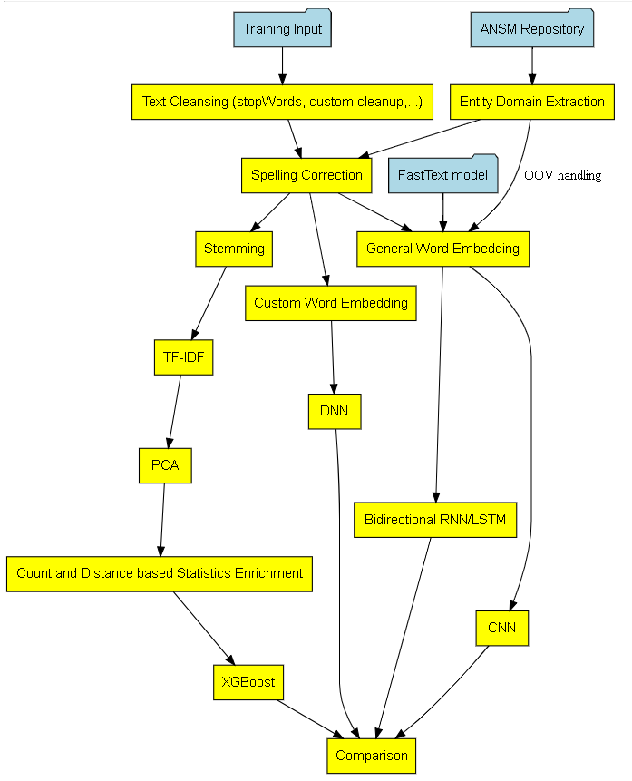
Modeling comparison

Slide 31
Model accuracy

Slide 32
Model interpretability

Slide 33
MODELING FLEXIBILITY

Slide 34
substainability

Slide 35
Winning/BEST practice
ACADEMIC Comparative study isolating techniques and their variants
Objective is to highlight their respsective strength and weakness
BEST practice usually recommends to
Try several techniques and keep the one delivering the best performance
Combine them
Rnn and cnn architectures
Word embedding + manual feature extraction

Slide 36
Binary classification

Slide 37
takeaways
Non conclusive performance results (64% F1-score)
Extracting sense from natural language is hard ( especially familiar french !)
Too few samples and too many target classes
Expect better gain with sequence modelinG
Unfair comparison favouring deep learning track
rewarding Return of experience on key Data science methodology
DATA Exploration and analysis
Data preparation (feature representation)
Modeling/architecture selection
Hyper parameters search
Result analysis and improvement loop-back

Slide 38
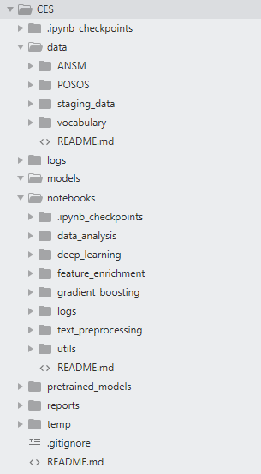
ANNEX
POSOS DATA CHALLENGE DESCRIBED AT
https://challengedata.ens.fr/fr/challenge/33/predisez_la_reponse_attendue.html
Runnable notebooks available at
https://github.com/jhuu32/CES

